Slide 1

Optimizing HiRep Lattice Simulations on CPU-based Computer Clusters
UKDF2025
PhD thesis (University of Plymouth, UK)
Dr Shidur Rahman, Research Fellow in HPC
Faculty of Engineering and Physical Sciences
Electronics and Computer Science
Building 53 | Room 4033 | University of Southampton, UK

Slide 2
Overview
Background
HiRep Performance Bottlenecks
Optimization Methodology
Experimental Results
Conclusions and Further Work
2
3

Slide 3

Background
link
site
QCD: studies the natures of forces between quarks: the fundamental building blocks of matter.
LGT (Lattice Gauge Theory): simulations involves the formulation of gauge field theories on a space-time lattice.
HiRep: Higher Representations research LGT simulations code - 4D space-time lattice to simulate.
  Dirac operator: Evaluation of Dirac operator accounts for around 90% of the computation time. Its optimization is crucial in this simulations (although deflated solver is being tested).
  Site - The point belonging to the lattice - Quark fields located at lattice sites.
  Link - The bond connecting two neighbouring sites - Gluon/gauge fields live on links.
  For each lattice site, we process its neighbouring sites and links and update the value of this site.
  Dirac equation represents a large linear system: e.g. typical size in QCD is 96 x 48³ x12 to 192 x 192³ x12.
  Entire lattice cannot be stored into a single processor’s memory – distributed memory.
  Only non-zero elements are evaluated.
  We have focused on Wilson Dirac operator formulation.
https://github.com/claudiopica/HiRep
3D Lattice

Slide 4
Parallel Programming Frameworks
MPI: (distributed data)
local data in each process
OpenMP: (shared data)
Sequential
Program on
each core
Master thread,
other threads
P
P
P
P
Some_Serial_Code
C
C
C
C
Explicit Message Passing by calling MPI Send & MPI Recv
M
M
M
M
Some_Parallel_Code
Some_Serial_Code
… Sleeping …
Network Connect
Hybrid: MPI + OpenMP

Slide 5

MPI-Only Code: Halo Exchange Problem
Boundary
HiRep was parallelized with MPI programming framework only.
Large lattice equally divided into MPI processes.
Each MPI process has a local lattice.
Local lattice:
  Bulk: inner segment, most contiguous in memory
  Boundary: next to bulk segment, where MPI send buffers are located.
  Computation of boundary sites depends on sites received from neighbouring processes.
Example: An 8x8 2D lattice decomposed into 4 MPI processes.
Bulk

Slide 6
HiRep Performance Inefficiencies
HiRep application was studied, analysed and profiled to identify its performance bottlenecks.
Main performance inefficiencies/challenges:
  Communication Overhead – Extensive data exchanges occur between MPI processes.
  Utilizing OpenMP is challenging due to the presence of workload imbalance.
  Inefficient Data Reuse of sites.
  Ineffective Auto-Vectorization.

Slide 7
MPI-Only to Hybridization (OpenMP-MPI)
MPI-Only
OpenMP - MPI
4 MPI processes
1 MPI process, 4 OMP threads
2D 8x8 lattice equally divided into 4 MPI processes.
Each MPI process handles a 4x4 local lattice segment.
Communication overhead due to large data transfers via the slow MPI interconnect.
1 MPI process runs 4 OpenMP threads
Each CPU core runs a single OMP thread
Communication reduced
Shared memory used by OMP threads
Communication: a single unified send buffer in place of many send buffers.

Slide 8
OpenMP Loop Collapse Optimization
Problem
Load imbalance among OpenMP regions – due to varying sizes of OpenMP regions.
Solution
  Integrated send-buffers within the geometry to minimize MPI data copy overhead.
  Modified Algorithm – Merged multiple OpenMP regions into one, creating a unified send buffer.
  Developed a lookup table for bulk and boundary segments in the local lattice to streamline operations.
Benefit
Computation: Loop iterations are equally divided into OpenMP threads so effective utilization of computational resources.

Slide 9
Experimental Setup
Hardware Platform
  A CPU-based Cluster with two Intel Xeon E5-2683 v4 (Broadwell) processors (nodes).
  Two sockets per node.
  Each socket (Intel Xeon E5-2683 v4) supports 16 CPU cores.
  Each socket features a 40MB L3 cache.
  64 CPU cores in overall.
  Network Interconnection: Intel® Omni-Path with a high bandwidth of 100 GB/s
Performance Metrics: FLOPs, Bandwidth, Execution time, and Speedup.
Input Sizes: A wide range of input sizes was used, ranging from 4 x 16³ to 32 x 16³, resulting in lattice memory sizes from 50MB to 805MB.
Although scaling performance validated in a way larger environment, e.g. HIPPO, LUMI, and others.

Slide 10
Hybridization (OpenMP-MPI) + Loop Collapse
x1.35 speedup gain over baseline version.
HLC = Hybrid Loop Collapse
Why is HLC(mpi=4, omp=16) better?
  Efficient use of shared memory by OpenMP threads.
  Local memory access within a NUMA domain.
  No NUMA violations.

Slide 11
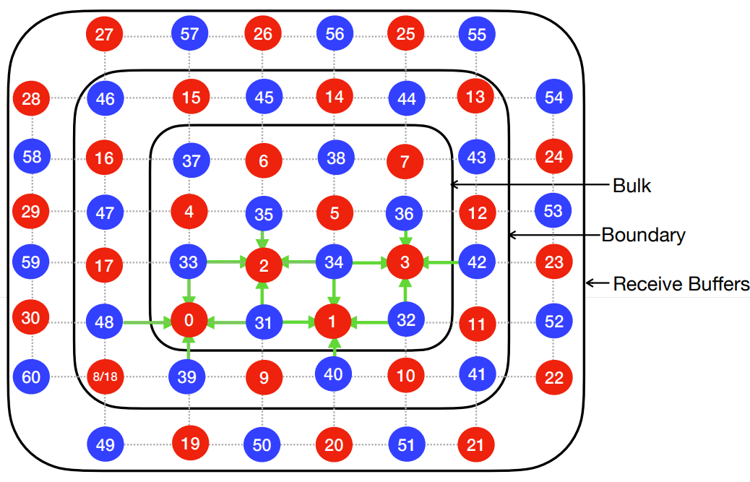
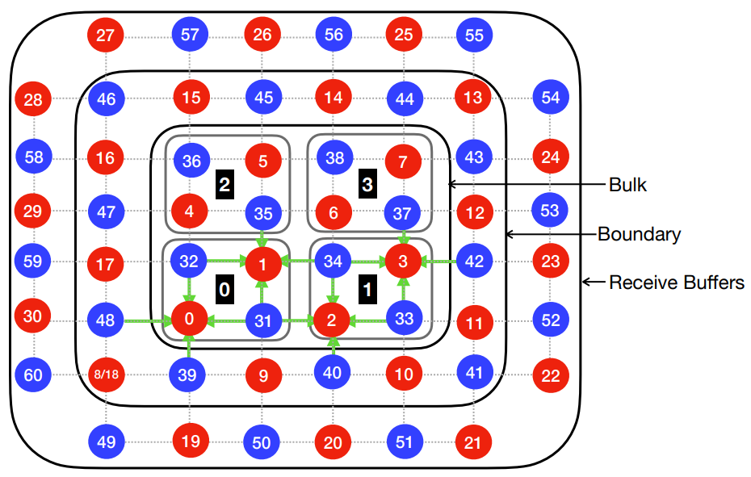
Data Access Patterns Optimization
Challenge: Non-contiguous memory access patterns.
Proposed Method:
  Improved data reuse in L3 cache.
  Fewer main memory accesses.
  Leveraged HiRep data access patterns.
Non-Path-blocking
Path-blocking

Slide 12
Experimental Results (1)
Achieved x1.18 speedup over original implementation (MPI-Only).
Benefits of cache reuse are evident when the lattice size per MPI process is small.
When the lattice size per MPI process is large, data cannot fit into L3 cache.

Slide 13
Vectorization
Challenge: Inefficient auto-vectorization.
Proposed Method:
  Applied Intel AVX2 and Clang vector intrinsics for efficient vectorization.
  Minimized number of vector intrinsics used.
  Selected efficient AVX2/Clang intrinsics to match the computational needs.
  Leveraged the available vector hardware registers.
  Efficient vectorization and potential higher data reuses.

Slide 14
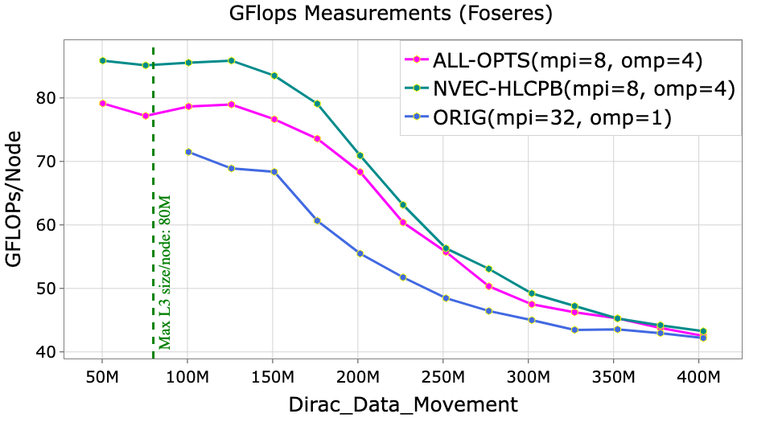
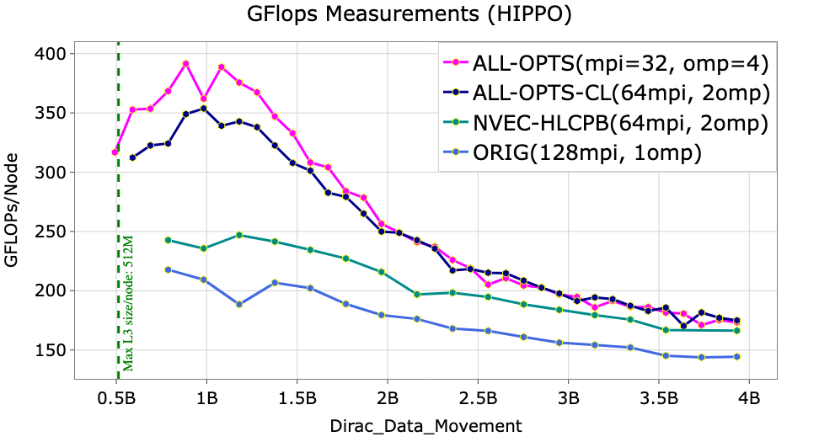
Experimental Results (2)
4x8^3 (125.83 MB)
9x10^3 (884.73 MB)
Notes:
Problem size used.

Slide 15
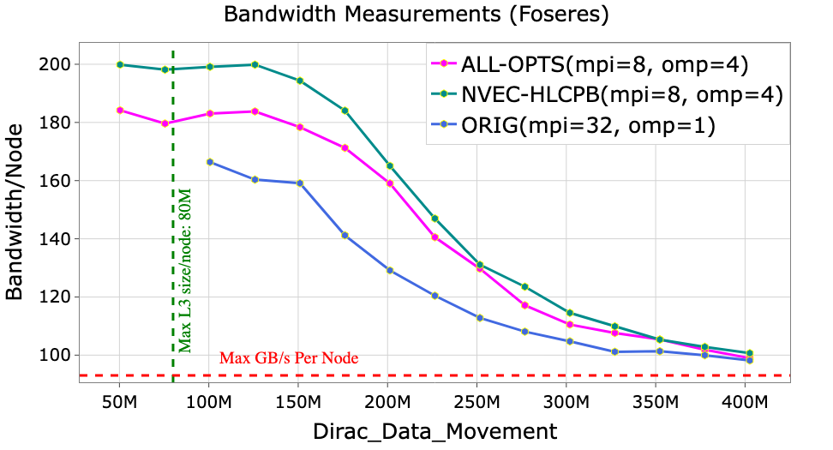
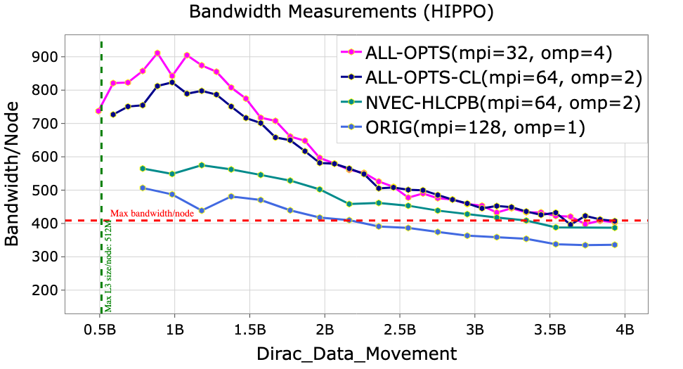
Experimental Results (3)
4x8^3 (125.83 MB)
9x10^3 (884.73 MB)

Slide 16
Conclusions and Future Works
Engineering (coding) and research efforts in this research work were high.
Up to x1.80 speedup over the original HiRep code.
Improved data reuse on L3 shared cache memory.
Vectorization achieved the highest performance gain.
Further work:
  Why AVX2 slower in Foseres environment.
  Evaluate performance on additional hardware platforms.
  Explore GPU optimization.

Slide 17

Thank you.
Do you have any questions?

