Slide 1
Emergent Lightweight Classifiers for Time Series Data on (AMD) FPGA
Jarlath Warner, John McAllister
Queen’s University Belfast
Karol Desnos
INSA Rennes, France

Slide 2

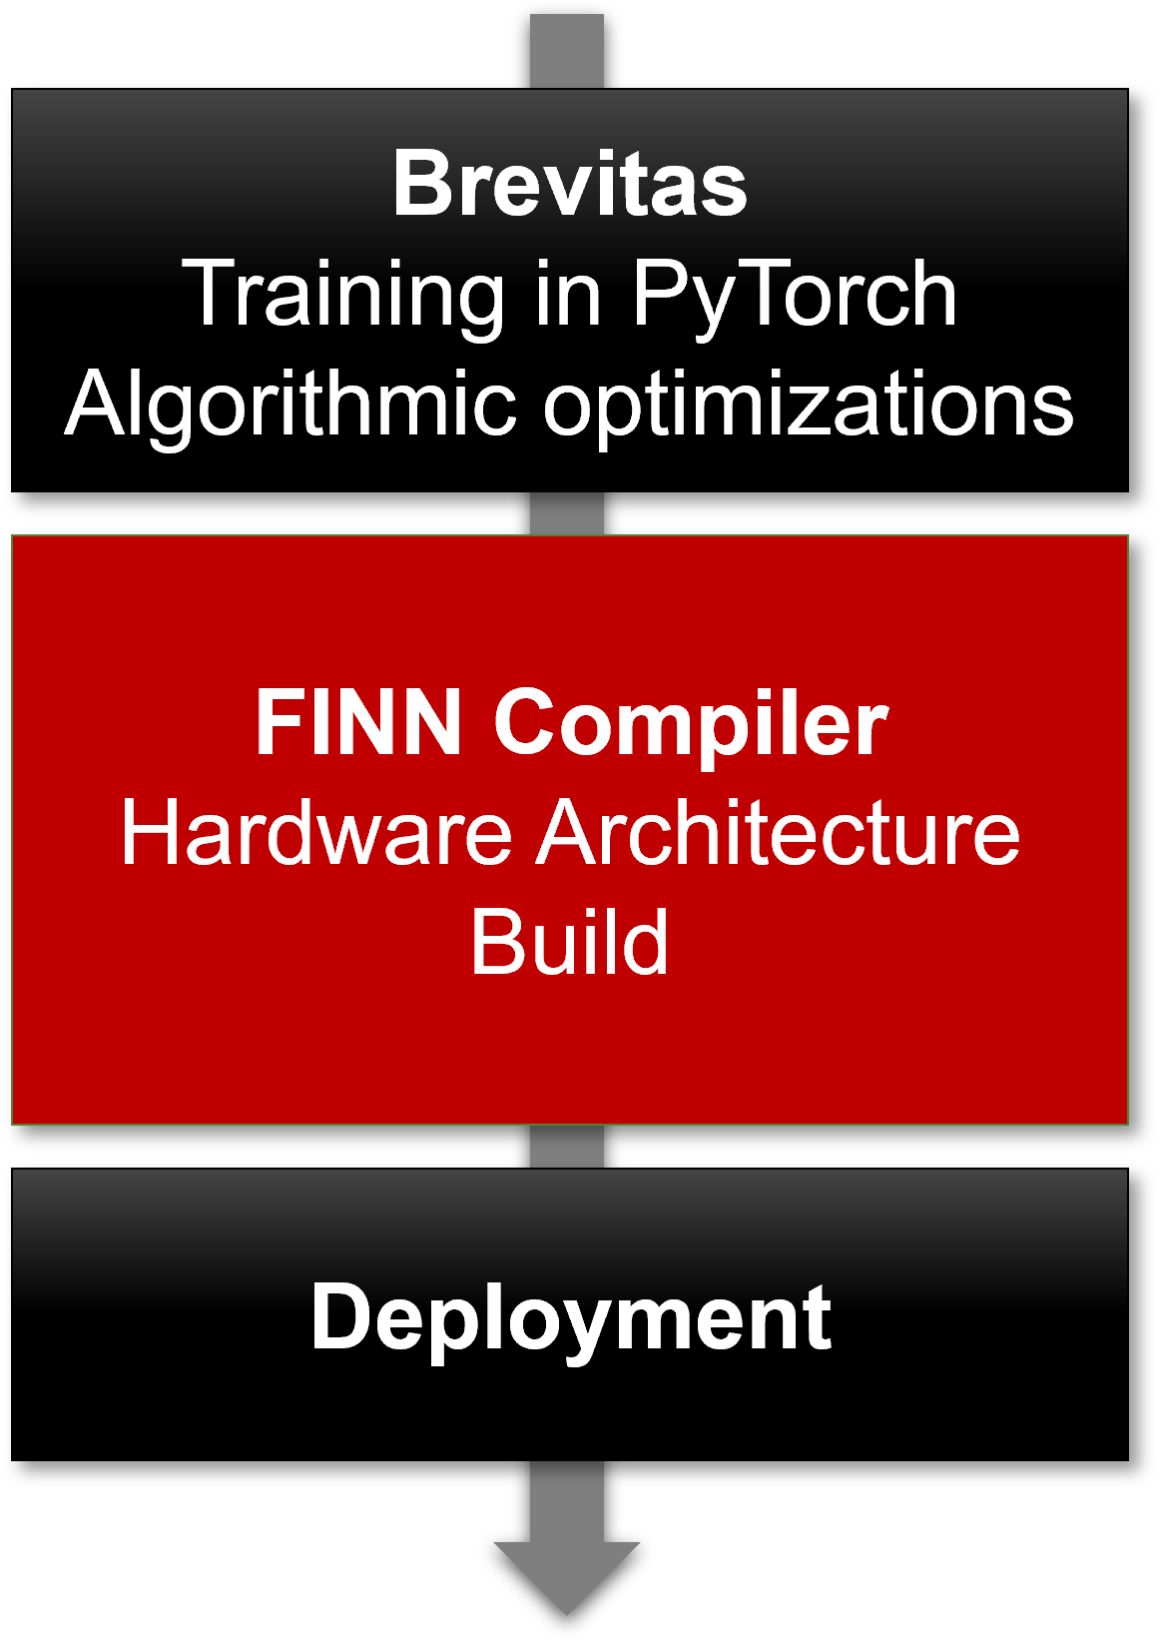
ML Classifiers on AMD FPGA
  Very limited on-chip memory storage
  Floating-point is problematic
FPGA
Cloud-scale
Highly Less accurate classifiers
Supported by lots of infrastructure
  Hardware
  Software (e.g. PyTorch, TensorFlow)
Highly Less computationally complex
Approximation
Highly accurate classifiers
Supported by lots of infrastructure
  Hardware
  Software (e.g. PyTorch, TensorFlow)
Highly computationally complex
There are edge-specific ML approaches:
Limited accuracy
Limited infrastructure
How does their performance and cost compare with approximate cloud approaches?

Slide 3
Tangled Program Graphs - Structure
t₂
streaming data
t₁
a₁
p_{0,0}
t₃
classes
p_{0,1}
a₀
p_{0,n}
t₀
t₄
a₂

Slide 4


Tangled Program Graphs - Synthesis
Labelled data
Labelled data
add
mult
shift
Random TPG generation
add
mult
shift
Fitness evaluation
Genetic Evolution
Vitis HLS C++
C++
Code Generation

Slide 5
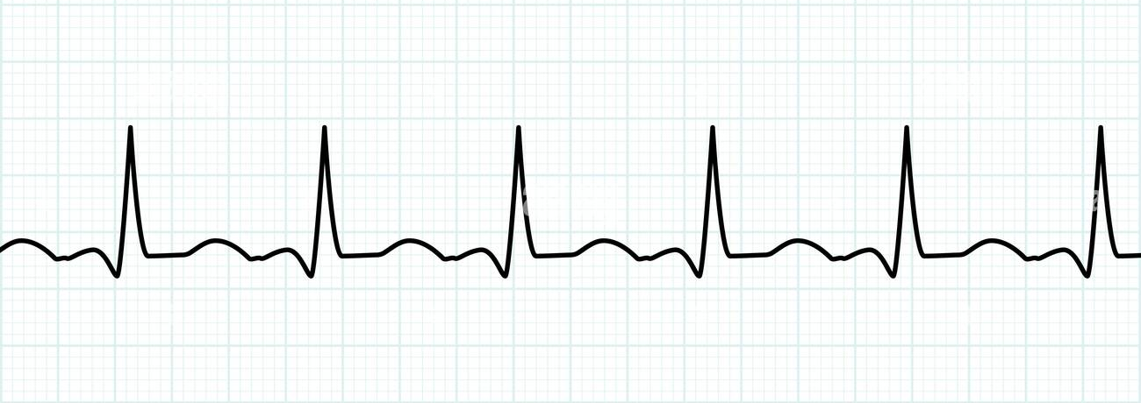

Test Cases – AMD Zynq
Network Intrusion Detection
ECG
 | TPG | 1 | 2 | 3
Precision |  | 16 (2) | 16 | 16
Accuracy | 94.3 | 90.2 | 93.3 | 92.7
LUT | 21513 | 3179 | 4411 | 22169
DSP | 61 | 0 | 83 | 69
BRAM | 1 | 0 | 0.5 | 35
T (MSamples/s) | 0.27 | 86.3 | 3.0 | 2.57
Latency (ns) | 3655 | 428 | 398 | 386
 | TPG | 1 | 2 | 3
Precision |  | 33 (2) | 33 | 33
Accuracy | 89.3 | 87.0 | 80.3 | 80.41
LUT | 38573 | 6153 | 192071 | 33054
DSP | 97 | 0 | 0.5 | 0
BRAM | 1 | 25 | 38 | 7
T (MSamples/s) | 0.12 | 110.8 | 0.9 | 0.73
Latency (ns) | 8592 | 3512.3 | 1322.0 | 1367.8

Slide 6
Tangled Program Graphs - Structure
t₂
streaming data
t₁
a₁
p_{0,0}
t₃
classes
p_{0,1}
a₀
p_{0,n}
t₀
t₄
a₂

Slide 7
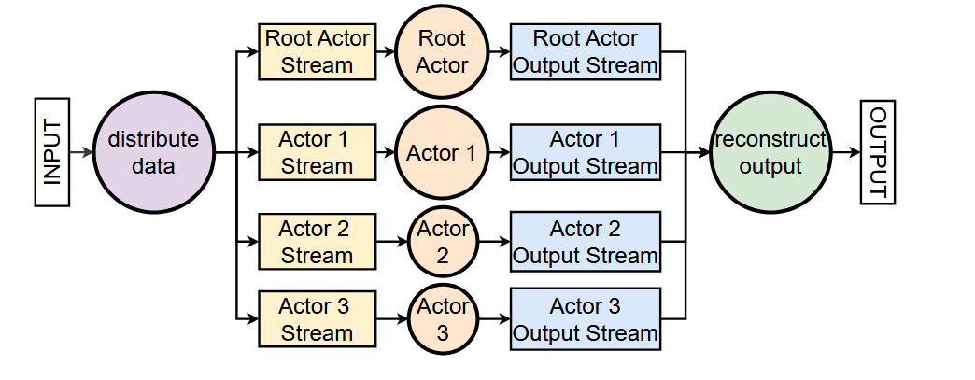
Dataflow-ising

Slide 8
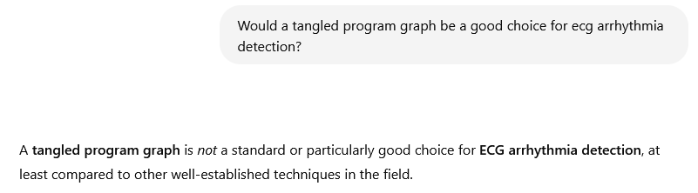
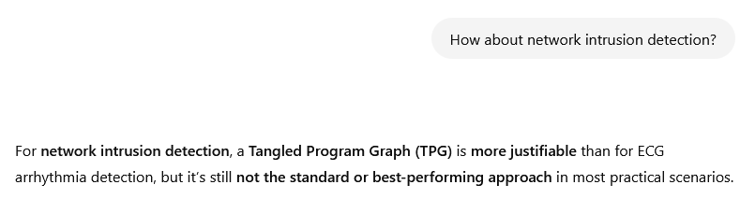
LLM Propaganda

Slide 9
Test Cases – AMD Zynq
Network Intrusion Detection
ECG
 | TPG (+D) | 1 | 2 | 3
Precision |  | 16 (2) | 16 | 16
Accuracy | 93.18 (93.18) | 92.7 (90.2) | 93.3 | 92.7
LUT | 2849 (1045) | 2851 (3179) | 4411 | 22169
DSP | 0 (12) | 0 (0) | 83 | 69
BRAM | 0 (0) | 0 (0) | 0.5 | 35
T (MSamples/s) | 152.4 (175.6) | 152.4 (86.3) | 3.0 | 2.57
Latency (ns) | 39.4 (45.6) | 944.8 (428) | 398.5 | 390
 | TPG (+D) | 1 | 2 | 3
Precision |  | 33 (2) | 33 | 33
Accuracy | 94.33 (94.33) | 92.9 (87.0) | 80.3 | 80.41
LUT | 3092 (1671) | 3409 (6153) | 192071 | 33054
DSP | 0 (8) | (0) 0 | 0.5 | 0
BRAM | 0 (0) | 5.5 (25) | 38 | 7
T (MSamples/s) | 188.9 (191.5) | 205.8 (110.8) | 0.9 | 0.73
Latency (ns) | 52.9 (67.9) | 5098.1 (3512.3) | 1322.0 | 1367.8

Slide 10
Tangled Program Graphs - Synthesis
Tangled Program Graphs are known to be:
  Very computationally efficient
  Can’t reach the same peak accuracy as deep neural nets, on the same applications
But
  There are numerous applications where neural nets aren’t as good
  Classifier design for FPGA is necessarily an exercise in approximation
For two (randomly chosen) time series applications
  TPGs are highly competitive with FINN, hls4ml, fpgaConvNet
  Are they all of smaller, faster and more accurate??
Most importantly – is this useful??

