Slide 1

eFutures Tribute
Professor Roger Woods
Queen’s University Belfast

Slide 2
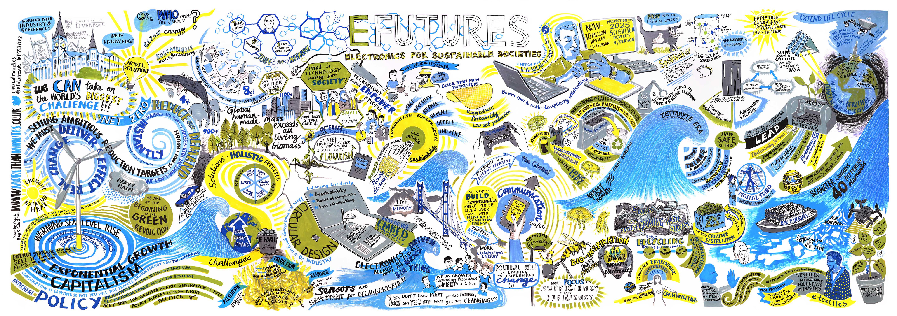

EPSRC-funded Network+ on current, and future, electronic systems.
Strategy
Community
Linking to key priorities
Establishing and supporting trajectories
Challenge-led
Sustainability
Networking across the academic domains
Industry links
Collaborations
Pipeline
International links
Multidisciplinarity
Support for researchers
Training
Holistic ecosystem

Slide 3















The eFutures Project is an EPSRC collaborative project led by Queen’s University Belfast and involves the following universities:

Slide 4


Semiconductor Research and Development: the UK Academic landscape

Slide 5






SEMICONDUCTOR: FUTURE UK R&D
UKRI has commissioned a study of the academic R&D in semiconductors.
The Department for Science, Innovation and Technology are the major stakeholder.
This strategic study will run until November 2025.
The Aim:
Represent the academic voice,
Facilitate novel international collaborations
Inform long-term strategic
interventions in this space.
efutures@qub.ac.uk.
Semiconductors: The Future of UK R&D

Slide 6



PROJECT PHASES
Landscaping
International
Picture
Horizon Scanning
Map & quantify UK academic research strengths
scope and establish opportunities for global collaboration
strategic foresight and scenario building to enable prioritisation
Sector Report
Collaboration Strategy
Roadmap 2050
Semiconductors: The Future of UK R&D

Slide 7


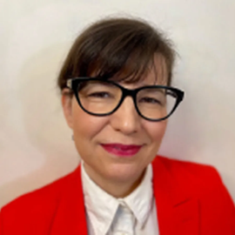

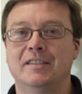
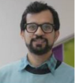
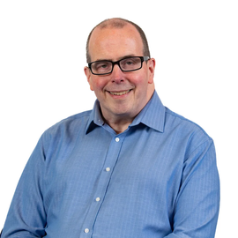


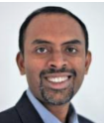






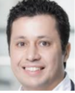
Advisory Group
University of Liverpool
Prof Ivona Mitrovic
Queen’s University Belfast
Beth Mc Evoy
University of Sheffield
Prof John Goodenough
Queen’s University Belfast
Prof Roger Woods
Queen’s University Belfast
Dr Hamza Shakeel
University College London
Dr Antonio Lombardo
University of Newcastle
Prof Anthony O’Neill
Kings College London
Prof Bipin Rajendran
University of Manchester
Prof John Goodacre
University of Cardiff
Prof Oliver Williams
University of Oxford
Prof Noa Zilberman
University of Swansea
Prof Mike Jennings
University of Cambridge
Prof Rachel Oliver
University of Southampton
Prof Graham Reed
Imperial College London
Prof Pantelis Georgiou

Slide 8



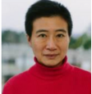

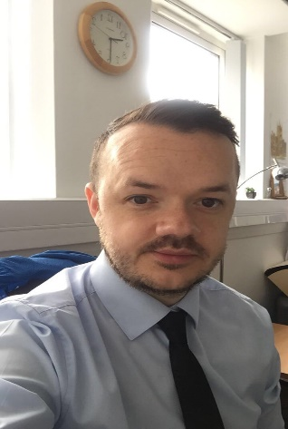
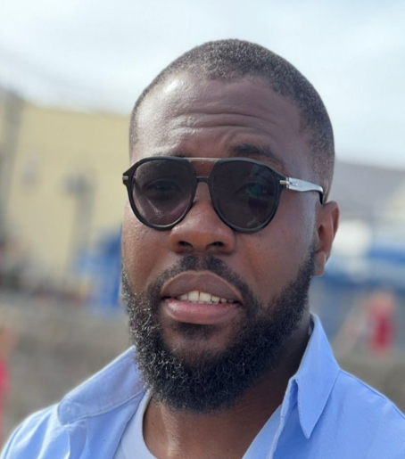
Advisory Group
University of Bristol
Prof Martin Kuball
University of Glasgow
Prof Hadi Heidari
University of Edinburgh Prof Rebecca Cheung
University of Warwick
Prof Layi Alatise
Project Support Team
Queen’s University Belfast
Natalie Magill
Queen’s University Belfast
Sean Morrison
Queen’s University Belfast
Arinze Uchenwa

Slide 9

Research
326
Surveys
Survey 1: Feb 2024, 214 respondents
Survey 2: Sep 2024, 112 respondents
Ref 2021 Review
554
554 institutions semiconductor case studies
EPSRC Grant Search
64
64 funded projects directly, aligned or underpinning SC research running to 2024 or beyond
Researcher Database
349
349 researchers from 32
universities
Advisory group
19
19 representatives from 16
universities

Slide 10

Participation
25
Structured Interviews
25 interviews with UK academics
(covering academic groups of
2103 researchers)
In person focus groups
182
12 focus groups / 182 pp
Online focus groups
179
7 focus groups / 179 pp
Paired in-person interviews
20
20 paired interviews with UK Civil
Service, MoD, UKRI, NCSC ,
industry
779
Scoping Workshops
54
Whitehall, Jan 2024
2 workshops / 54 pp

Slide 11
Key recommendations
1. Prioritise high risk, high reward research in: (i) advancing semiconductor
materials (including materials such as compound and 2D semiconductors);
(ii) designing and modelling novel IC architectures and; (iii) realising hybrid
and heterogenous systems.
2. Establish semiconductor prototyping capabilities in the UK across various
levels of TRLs based on exemplar international models such as South Korea’s
National NanoFab Centre or IMEC and create a small-scale silicon
manufacturing capability focused on R&D.
3. Increase R&D funding specifically for semiconductors and establish
collaborative communities of practice supported by Network+ grants, with
the aim of growing existing and creating new high quality cluster ecosystems.
Materially improve the proposition for researchers to remain in UK
academia through renumeration and various incentives.

Slide 12
Key recommendations
5. Grow a talent pipeline for a range of staffing in semiconductor R&D and
industry in the UK, with a specific aim of establishing a new model of doctoral
training across the core semiconductor topics and improving the training of
technical professionals.
Grow and ease the commercialisation of research from universities by
introducing substantial investment and more effectively exploit InnovateUK,
ChipStart, and UKESF support to help accelerate commercialisation of
university research; in addition, more effectively attract VC investment by
enhancing ‘crowd in investment’.
Establish a lightweight central organisation for semiconductors to provide
information on access to national semiconductor R&D facilities, work on a bold
curriculum on semiconductor skills, generate imaginative public campaigns on
semiconductors and support inward investment opportunities.

Slide 13

Semiconductors: Future UK R&D
Thank you

