Slide 1

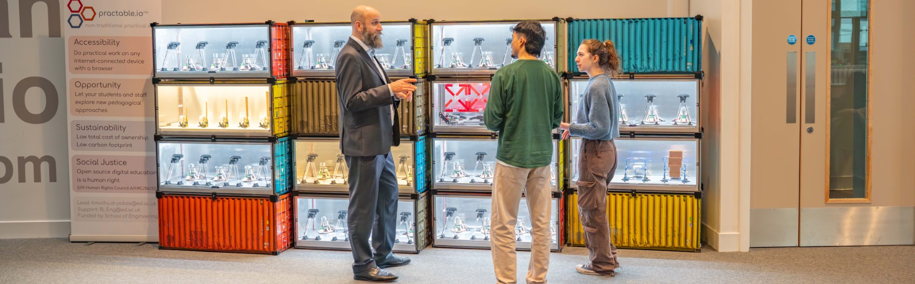
Online Practical Work
Timothy Drysdale
Chair of Technology Enhanced Science Education
Director of Strategic Digital Education
School of Engineering, University of Edinburgh
Notes:
VD introduce, how we met, contecxt as to why this is useful for HW globally connected learning, partnering physical and digtial laboratory opportunties to engage, deepen and

Slide 2
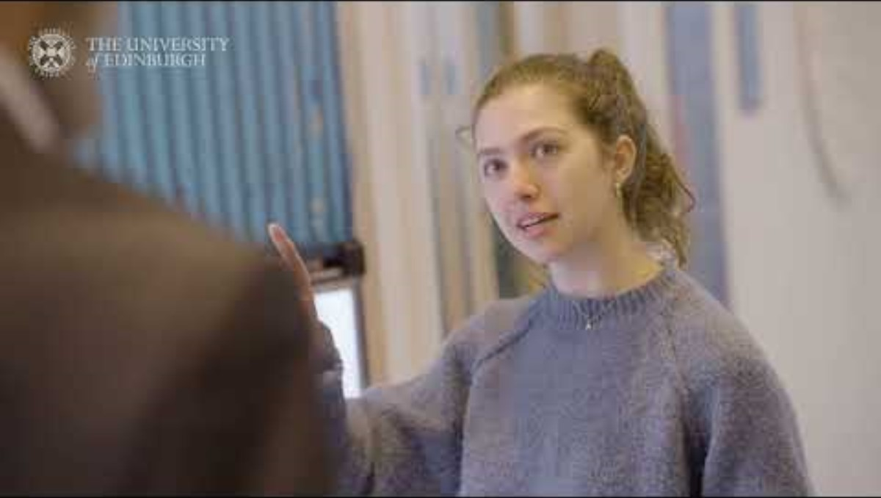

Slide 3
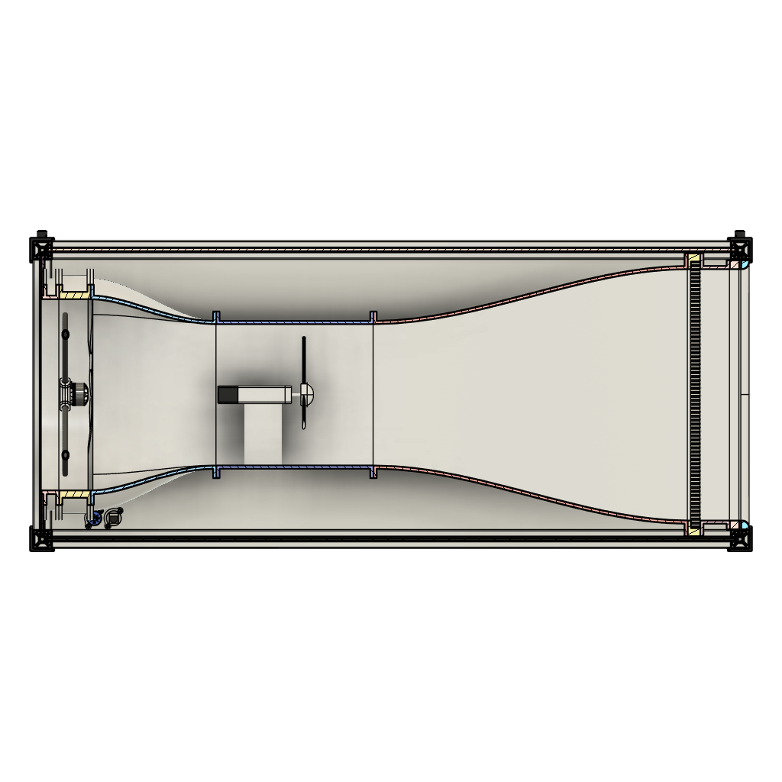
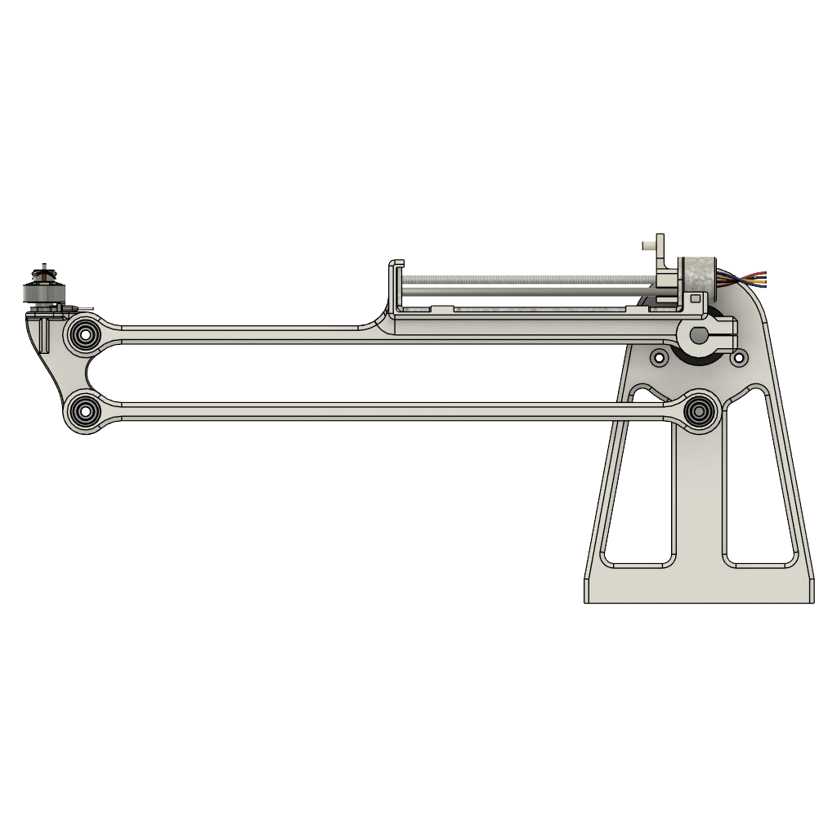
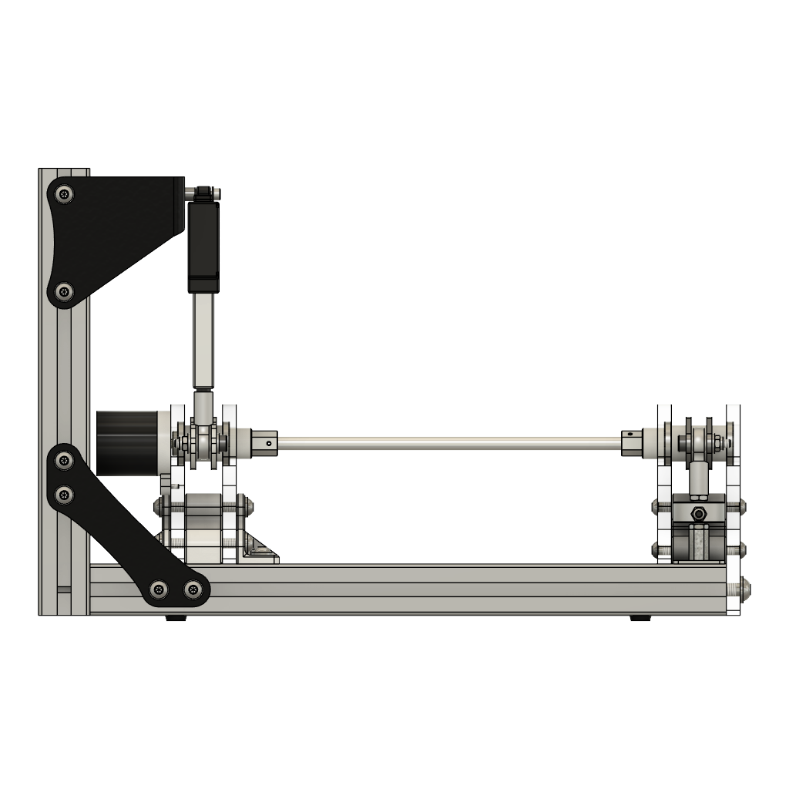
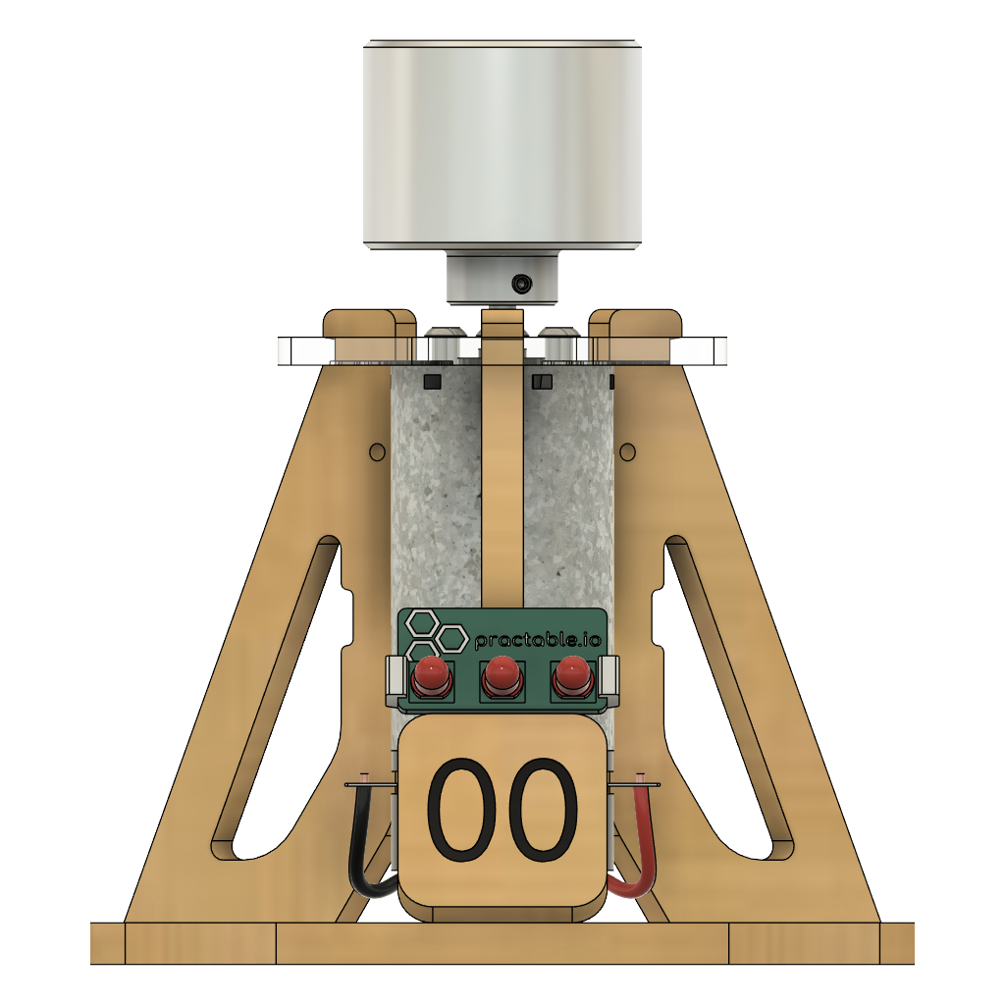
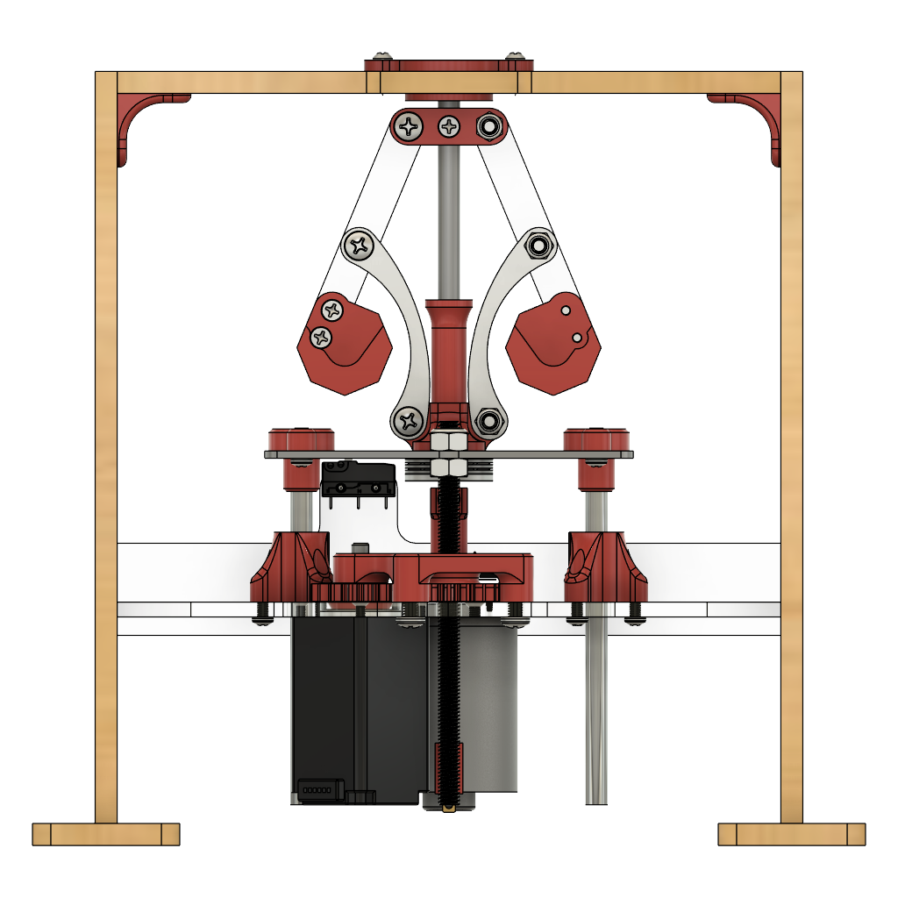
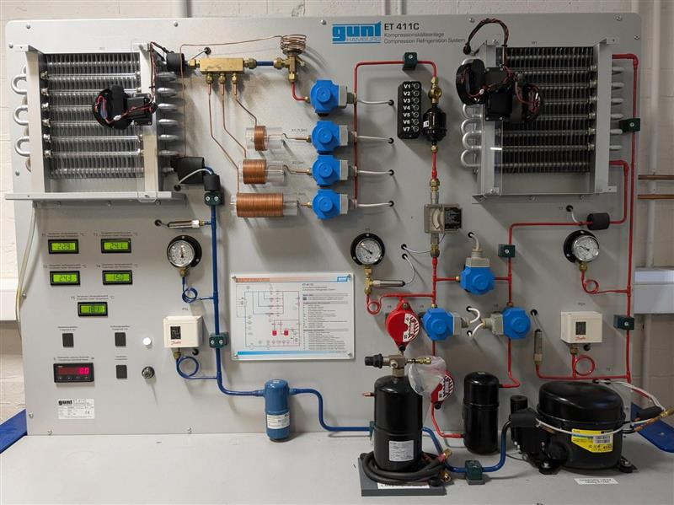
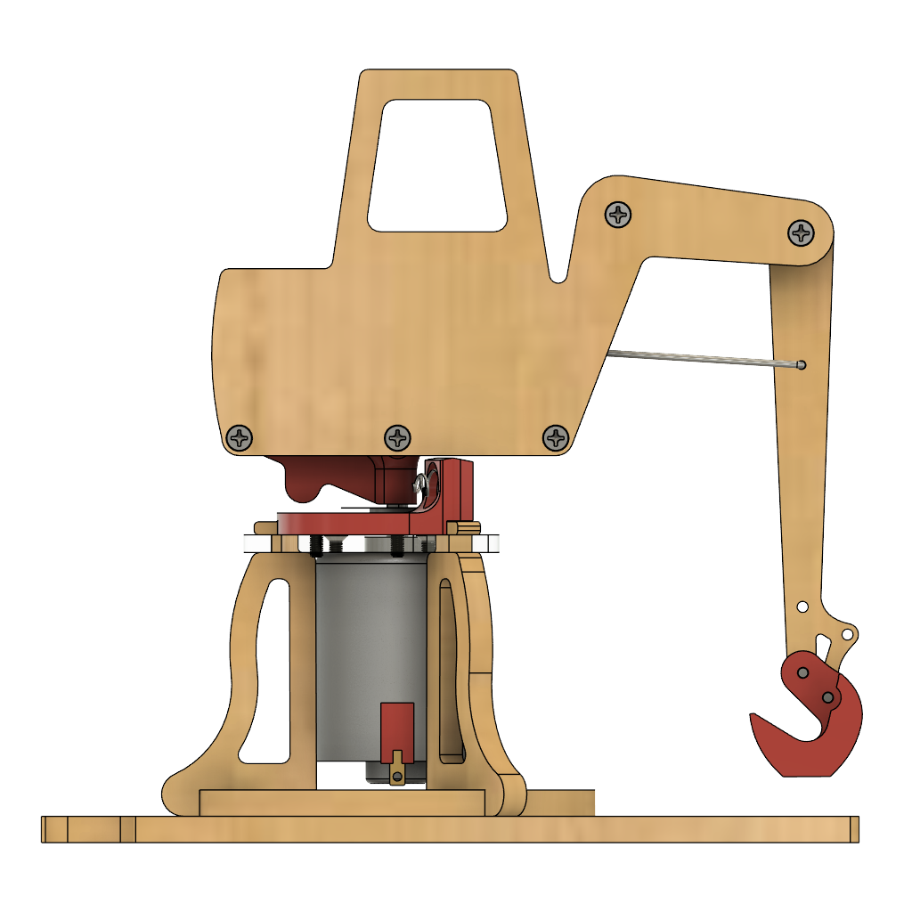
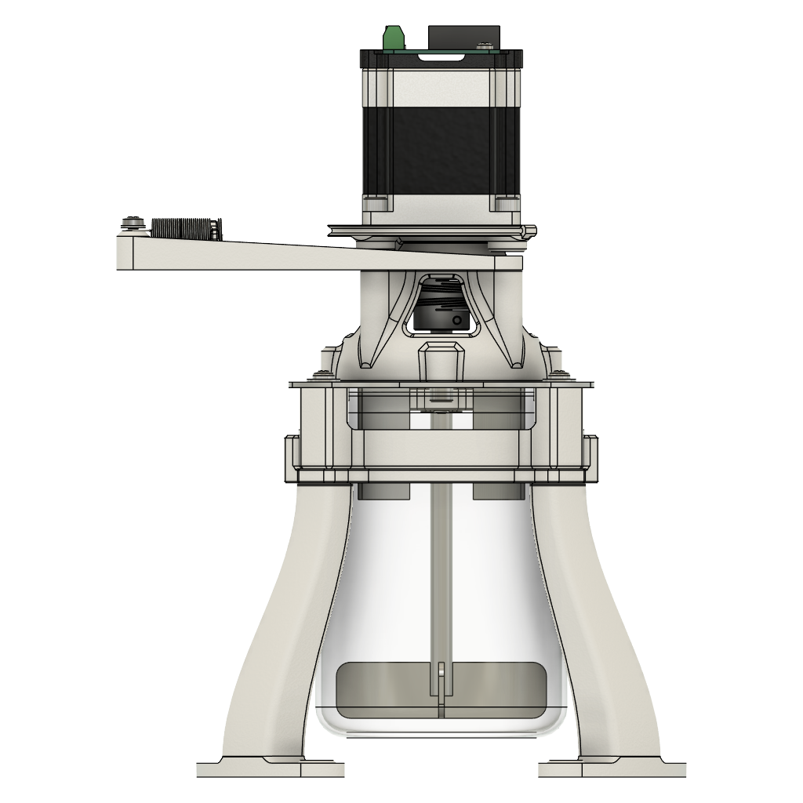
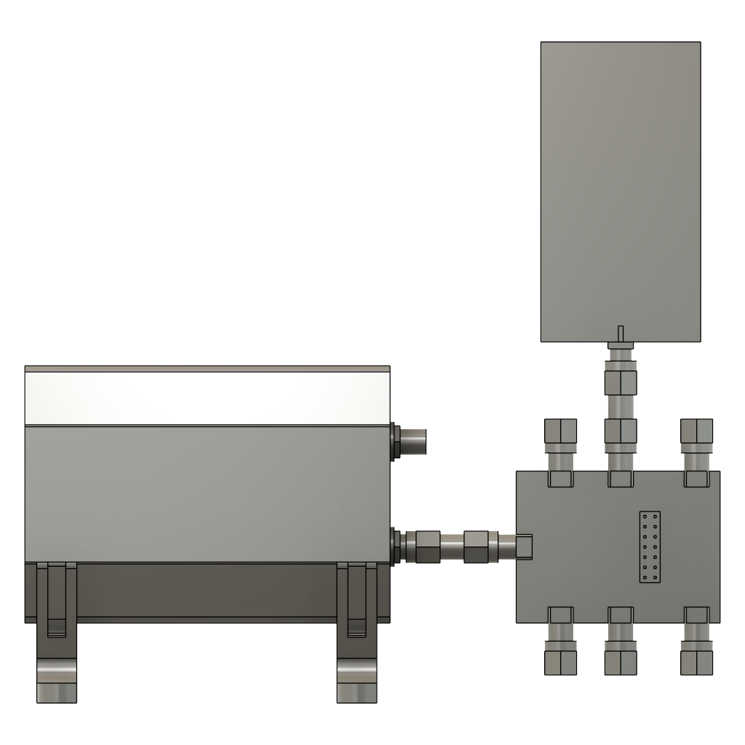
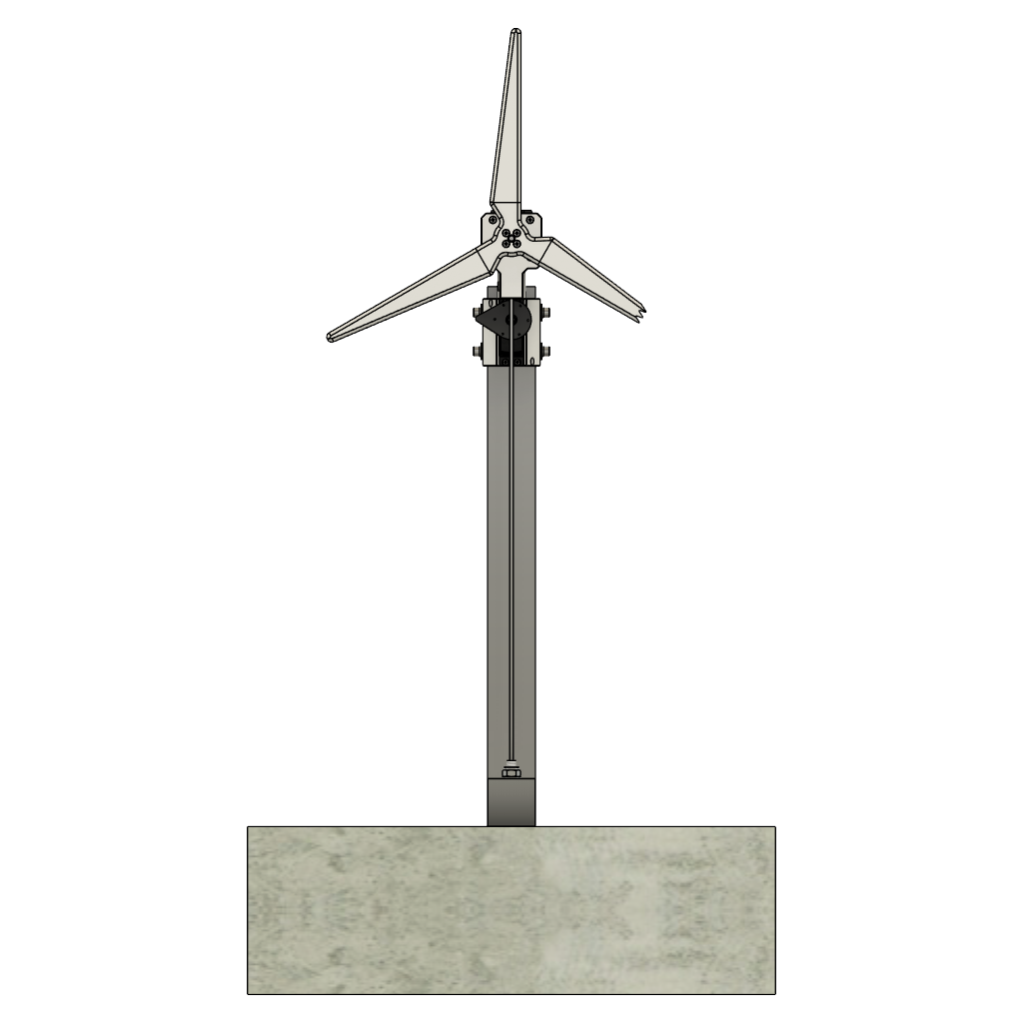
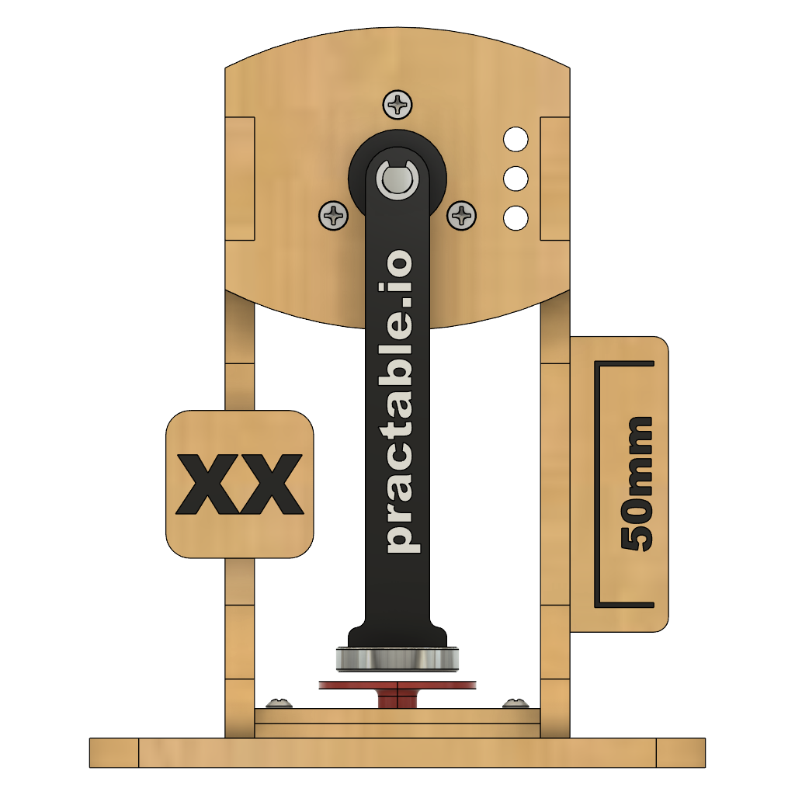
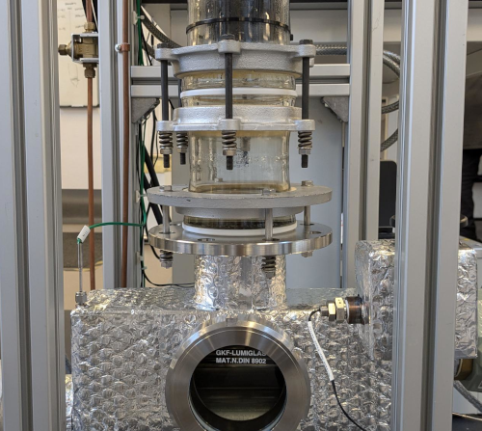
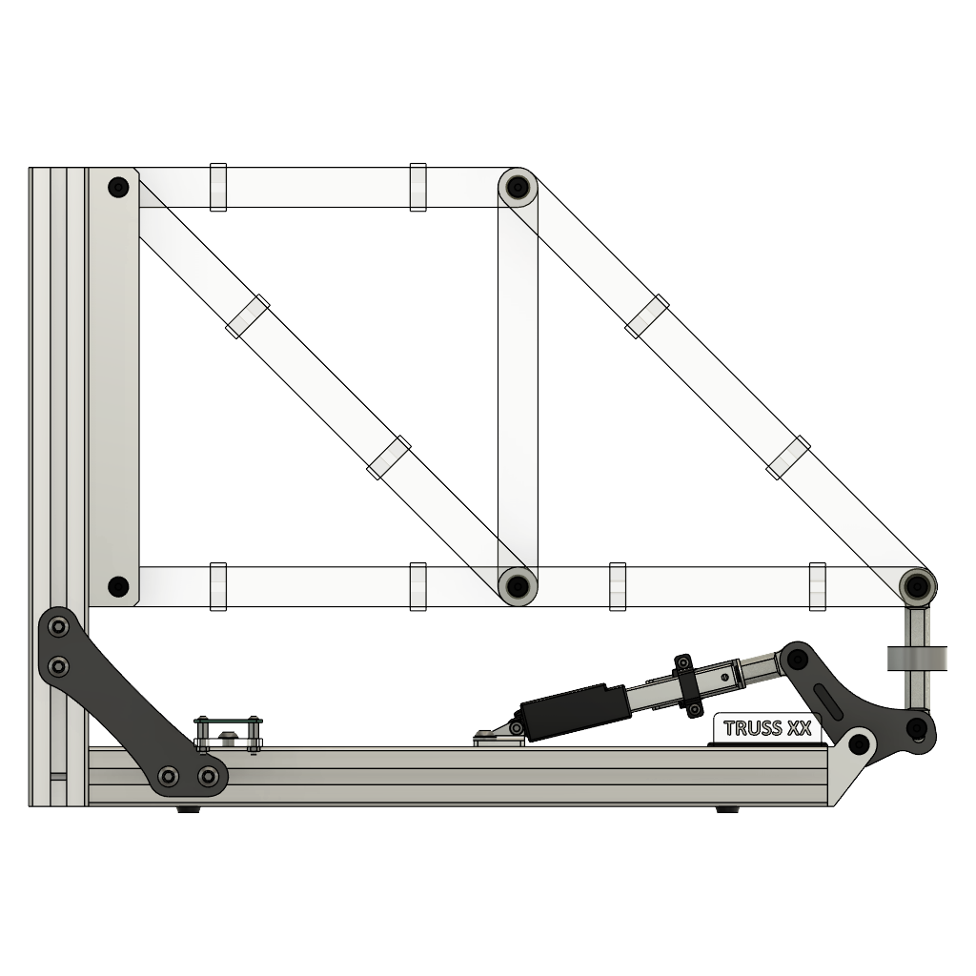
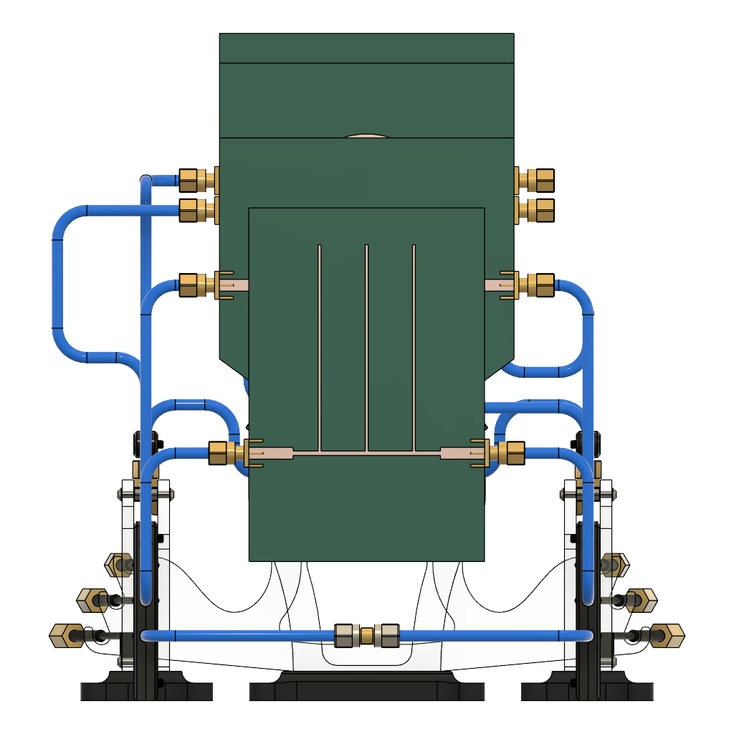
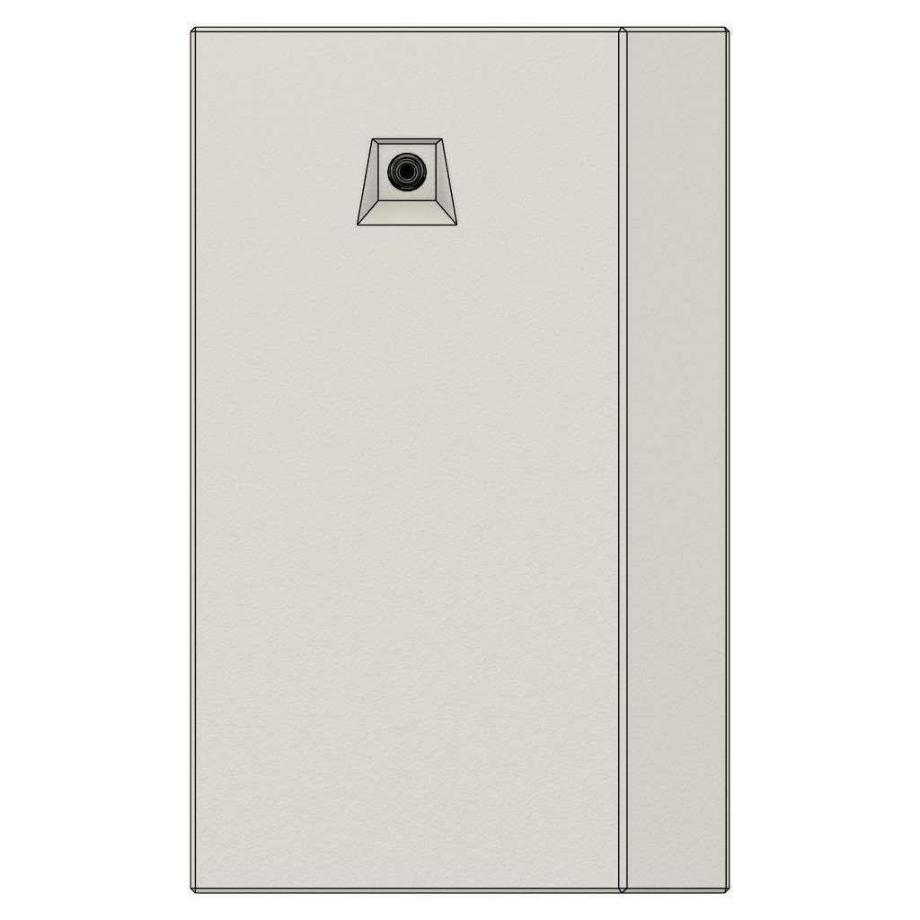
Torsion (twisting)
Wind turbine in tunnel
1-dimensional drone /
Energy vs power
Angular inertia /
Control systems
Governor
Radio frequency waves
digger
refrigeration
Viscosity / stirring liquids
Pendulum
Dynamics / resonance
>200 Experiments
Truss / Strain
Radio frequency components
Portal
9kw condenser

Slide 4
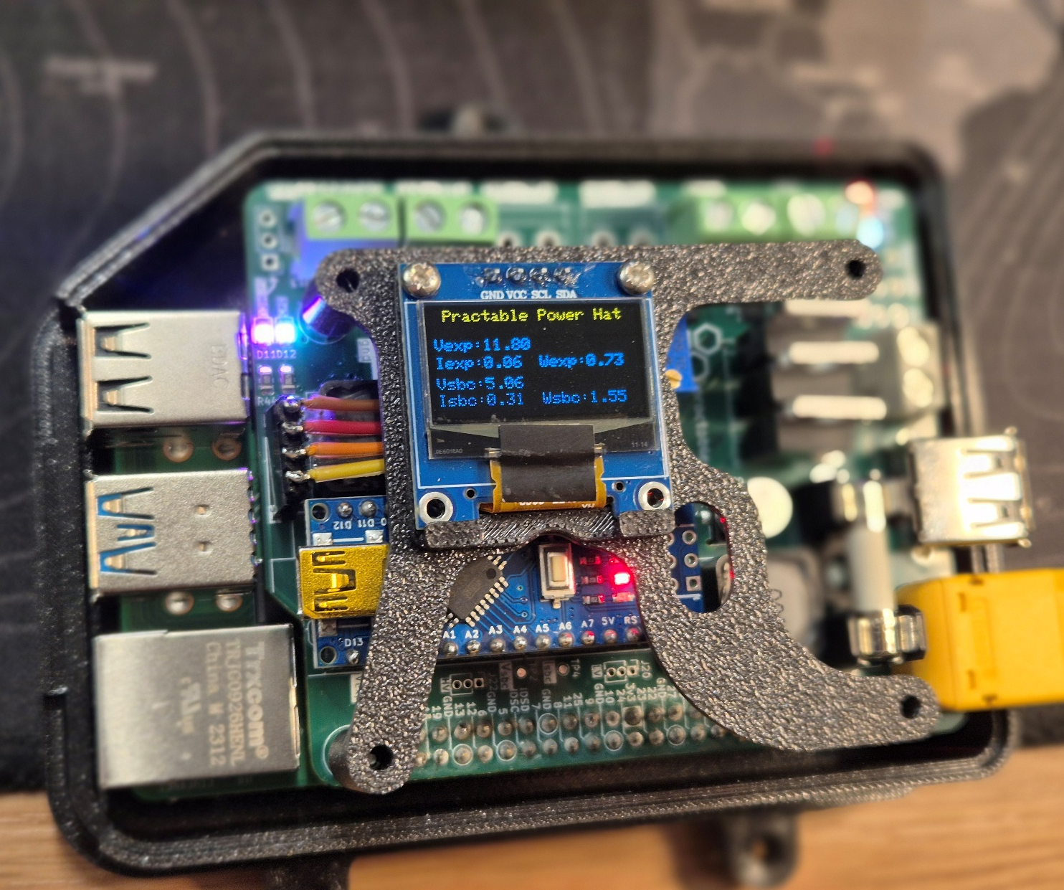
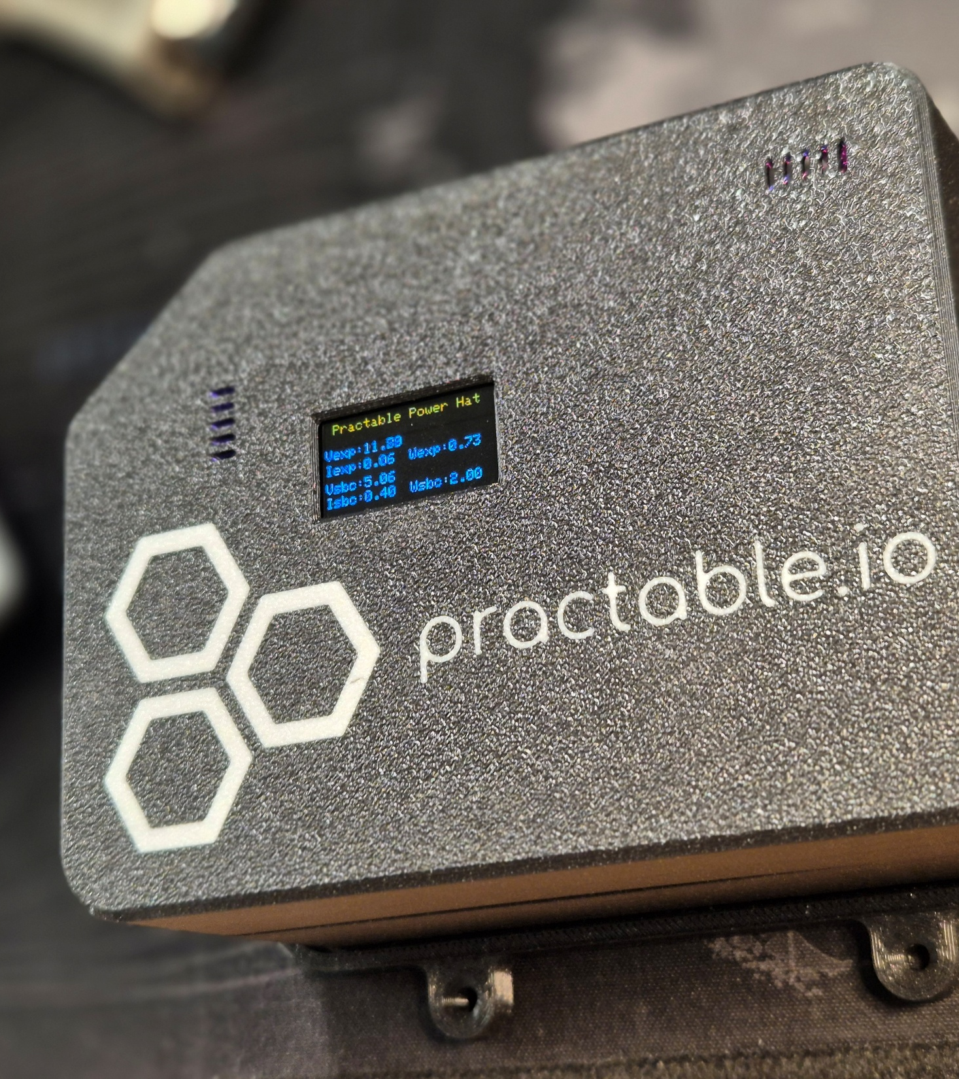
Portal – design your own experiments
Notes:
Those wee examples of co-design, but if you have talented creators on hand already, academics, students, technologists, technicians then you can use our portal to link your experiment to users online;

Slide 5
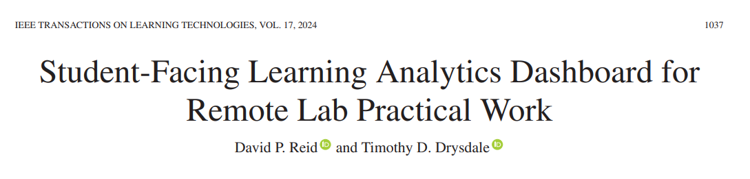
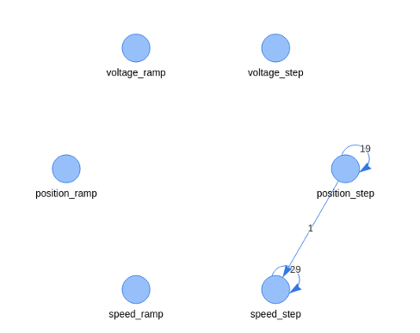
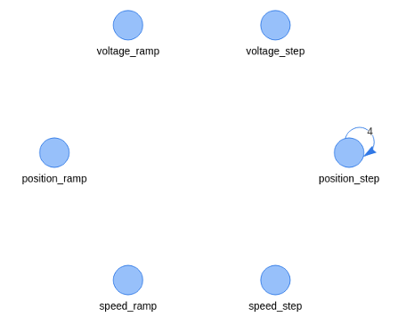

Slide 6
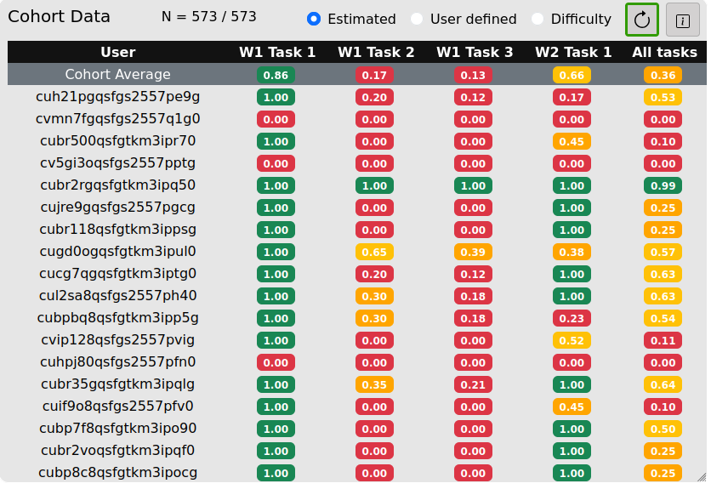

Slide 7
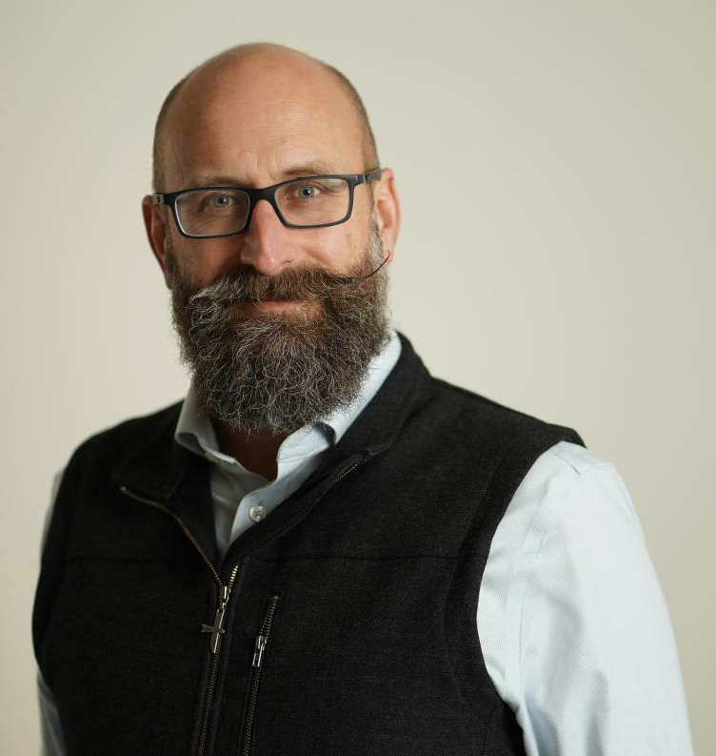
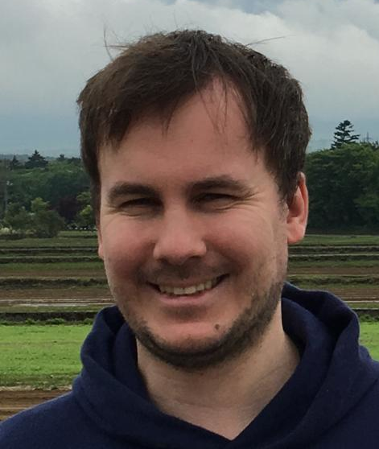
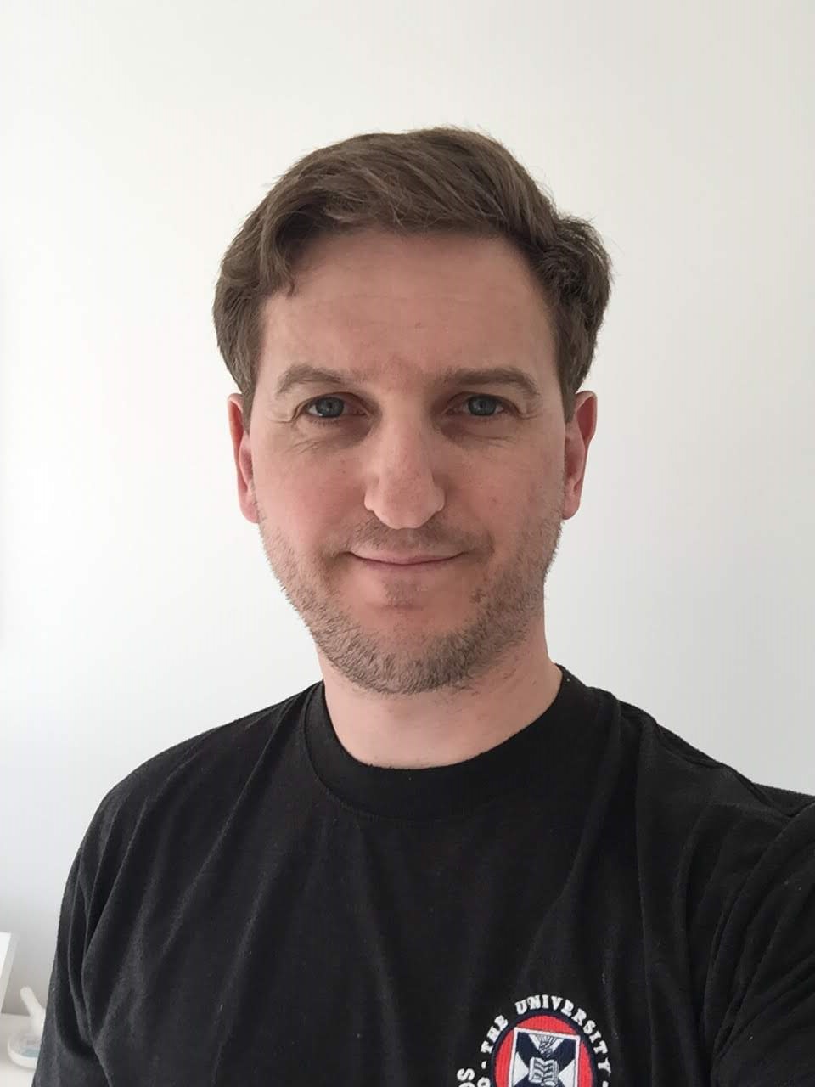
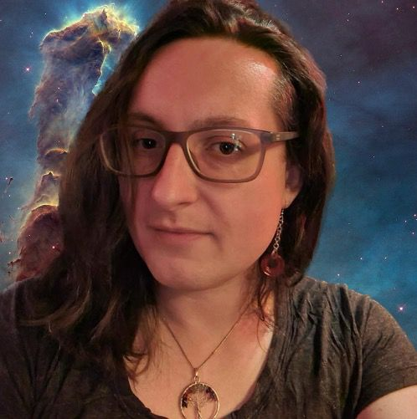






Award-winning team
Prof. Tim Drysdale
lead & architect
Dr David Reid
applications
Andrew Brown
Hardware
Imogen Heard
Electronics
Notes:
Mention GOLC from point of view of global community in this area

Slide 8
Educational research / features
Student-facing learning analytics
TaskCompletion & TaskExplore algorithms
Calculation assistants (how close are you?)
Virtual Assistant (pedagogically-sound chat bot)
Integrated Laboratory notebooks with assistance and feedback
Student-teacher-equipment-context interaction research
PhD Students: Sijie Zhou, Henry Zeballos, & Yiwen Xu
Co-supervision by: Prof Timothy Stratford,
Dr Dani Orejon Mantecon, Dr David Reid

Slide 9
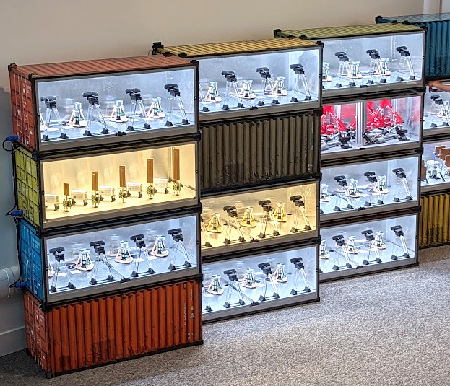
Enable growth
Improve education quality
No buildings required
timothy.drysdale@ed.ac.uk

